Slide 1
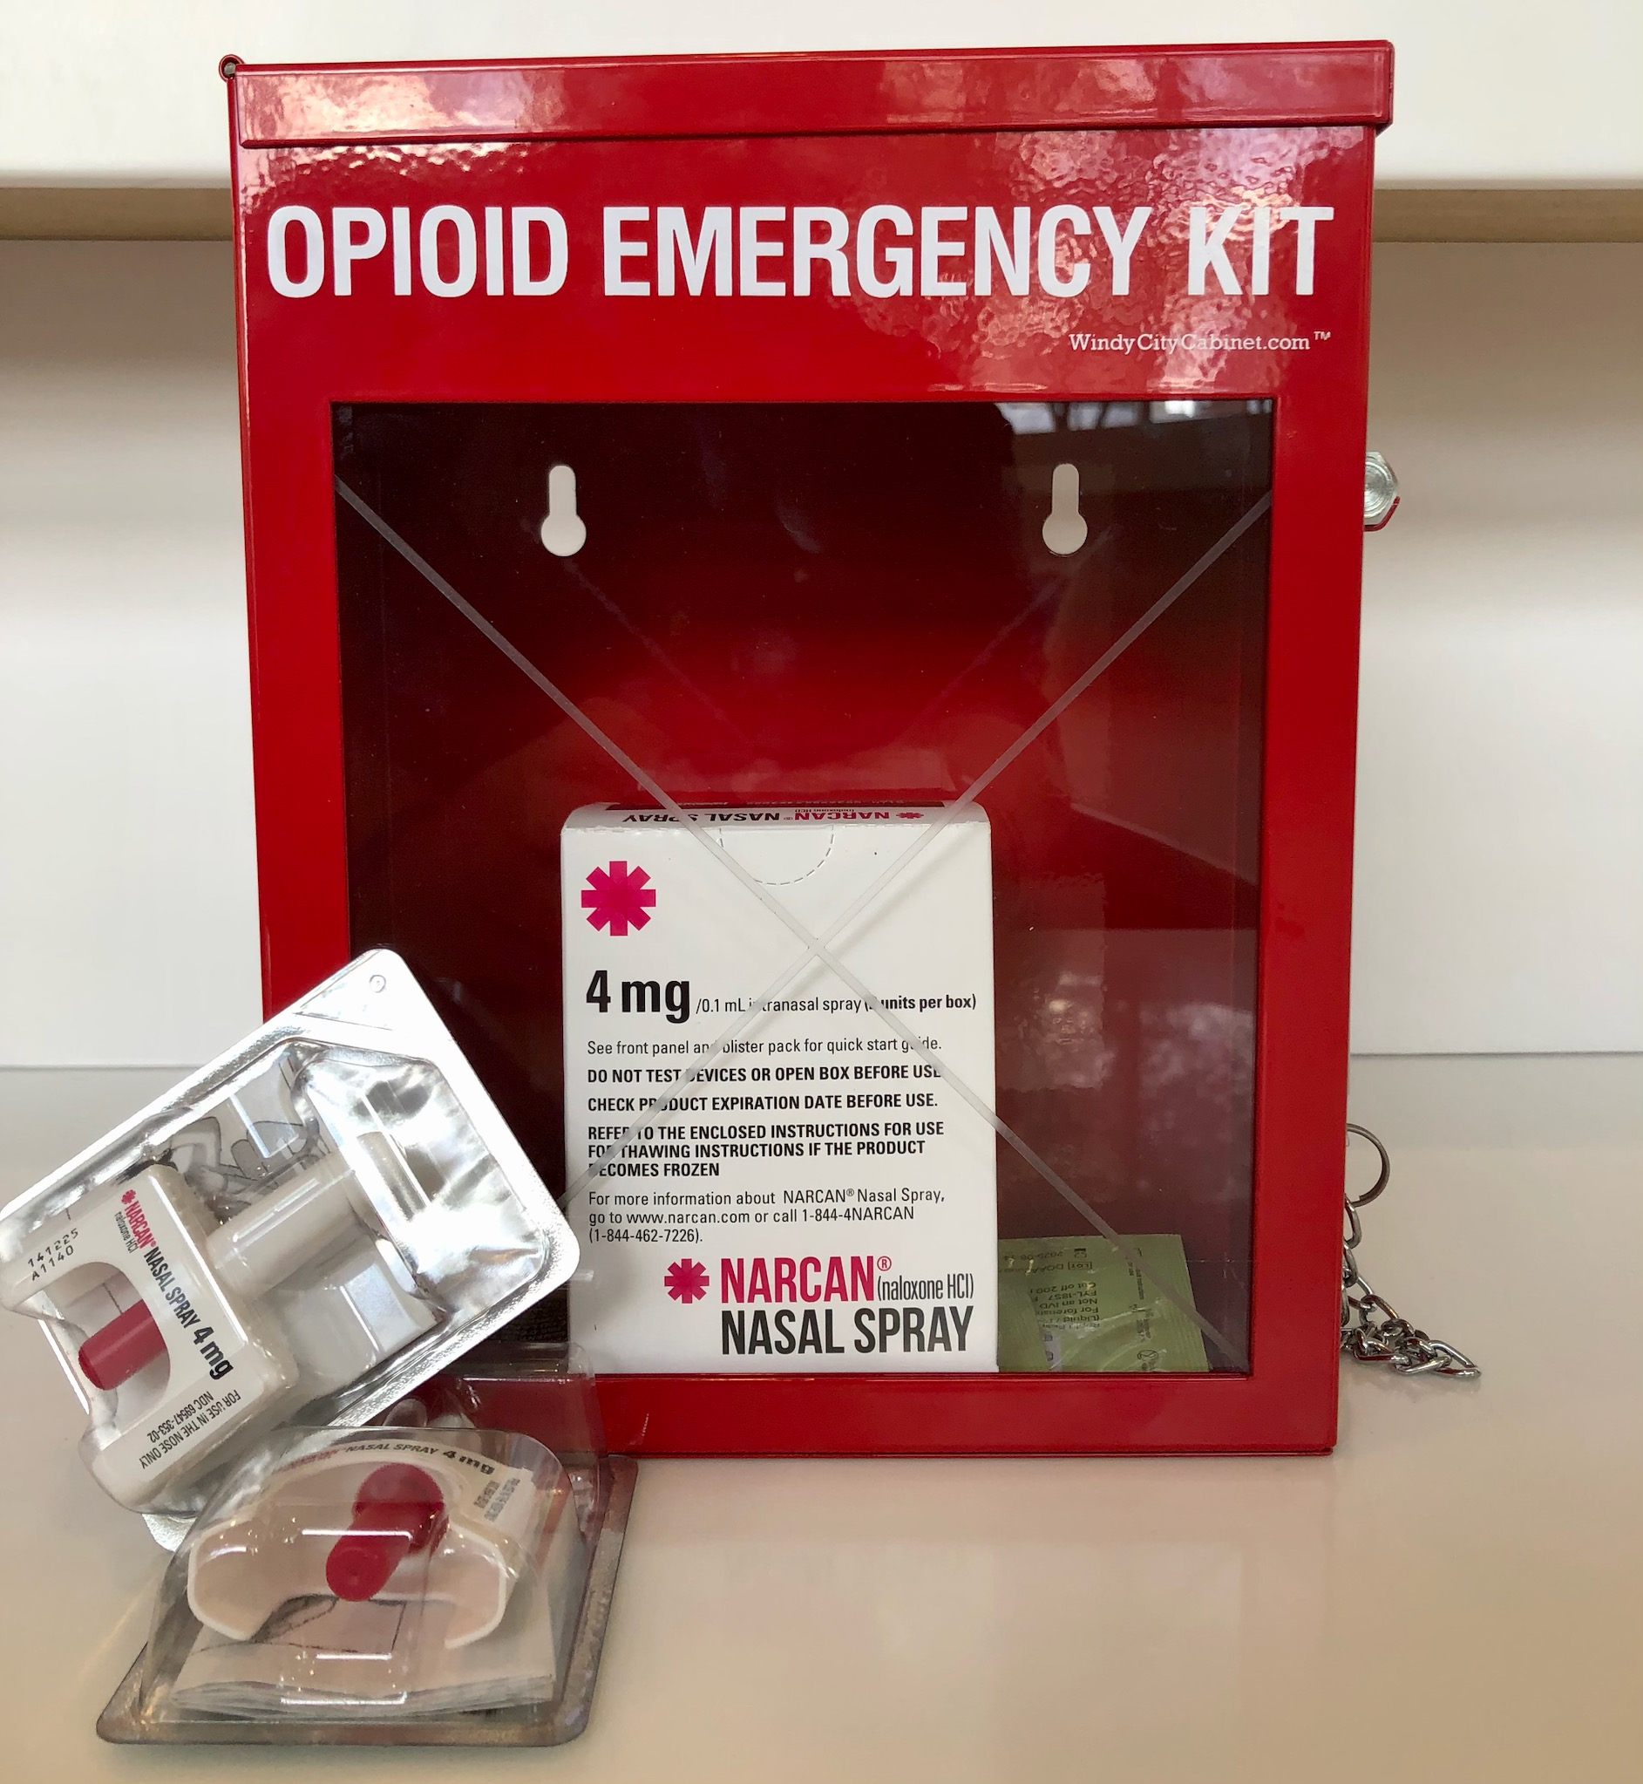
Narcan
Signs of an opioid overdose and the administration of Narcan

Slide 2
Signs of an opioid overdose
Click to Play

Slide 3
Signs of an opioid overdose continued
The following are signs and symptoms to look for to identify a potential overdose:
Loss of consciousness, limp body
Slowed breathing, choking
Small, "pinpoint" pupils
Pale, blue, or cold skin
Slowed heart rate
Drug paraphernalia (Do not handle needles, spoons, water bottle lids or powders)

Slide 4
Narcan Administration
Click to Play

Slide 5
Narcan Administration continued
If someone you know is experiencing any symptoms of an opioid overdose you should:
Dial 911 immediately.
Administer naloxone.
Try to keep the person awake and breathing.
If Certified, Start CPR if needed.
Turn the person on their side to prevent choking.

Slide 6
Narcan location at The Borra Center
Narcan is located next to the AED on the first floor of The Borra Center

Slide 7
Narcan location in JJC
Narcan is located next to the AED in JJC

Slide 8
Narcan location at Keese Hall
Narcan is located next to the AED on the first floor

Slide 9
Narcan location in Tech Lab
Narcan is located next to the AED in Tech Lab

Slide 10
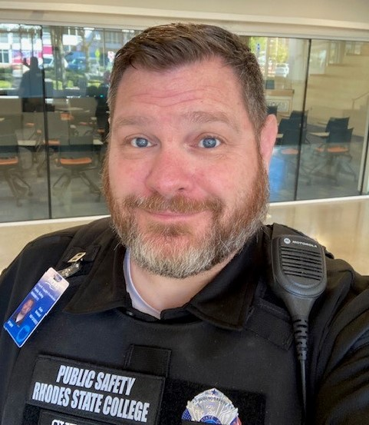
If you have questions contact Chad Cupples, Public Safety Officer & Coordinator
419-995-3011

